Slide 1
Hazard Insurance Review
Requirements & Documentation

Slide 2
Table of Contents
Document Type
Name of Insured
Property Address/Insured Location
Effective Date
Amount of Coverage
Type of Coverage
Deductible
Premium
Mortgagee Clause
Review of Insurance Company
Flood Insurance
Master Insurance Policies

Slide 3
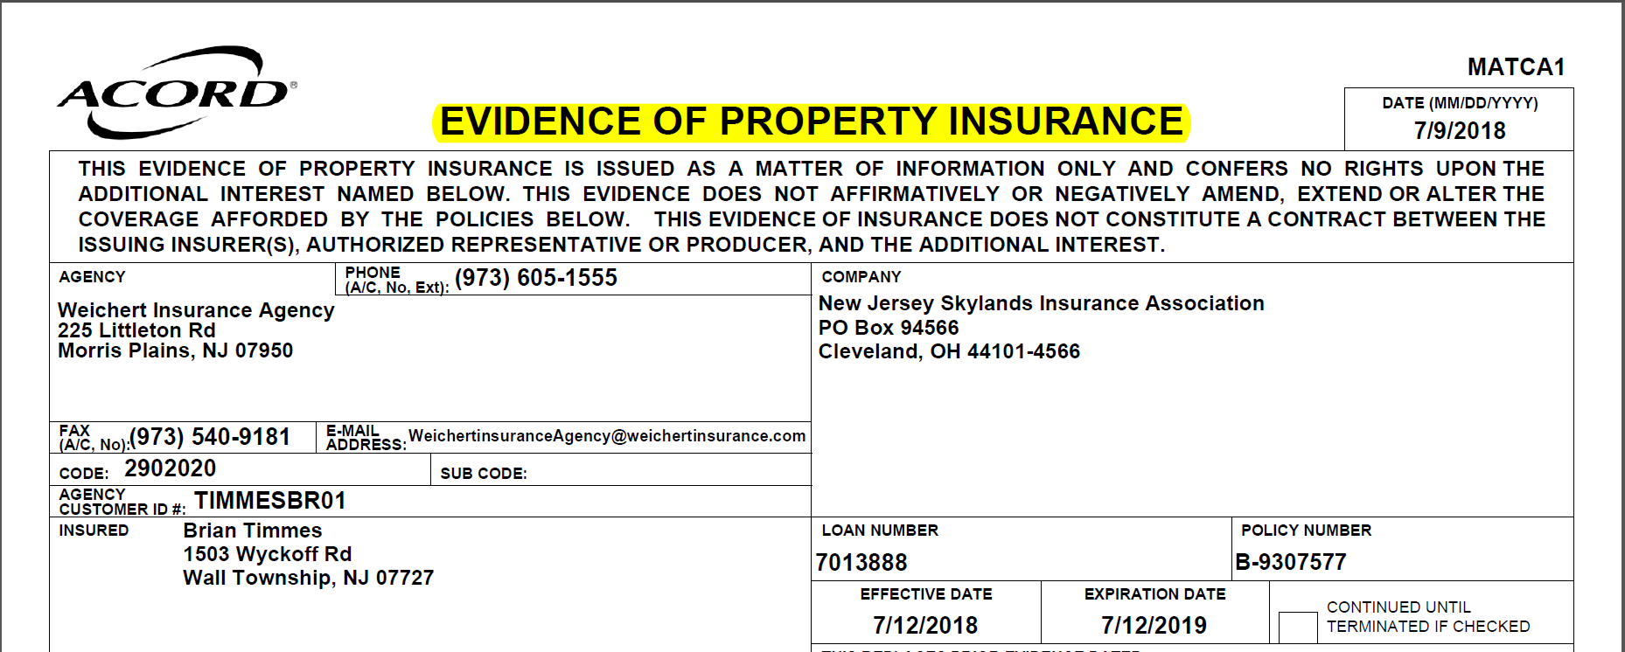
Document Type
Evidence of Insurance or Declaration Page is required.
Binders are acceptable on Purchase transactions with proof of paid receipt (must be paid in full 12 months)
NOTE: Regardless of type of policy a Policy Number is required. In addition estimates or quotes are not acceptable.

Slide 4
Name of Insured
Borrower and if applicable Co-Borrower must be reflected
Title only borrowers are allowed to be an insured but not required
Entity/Trust loans, the entity name must be listed. The guarantor(s) may be an additional insured.

Slide 5
Property Address/Insured Location
The Subject Property Address must be on the policy and must match the legal address, tax cert, USPS
Variations Acceptable
Street type or directional indicators can be abbreviated i.e. Ave., Blvd., NW or SE etc.
Exceptions for Areas, such as Area of Glendale, City of Los Angeles. Either Glendale or Los Angeles are acceptable as the Subject Property’s city.

Slide 6
Effective Dates
Purchase
Policy must be effective for 12 months with a start date no more than 30 days prior to the date of Funding.
Refinance
Policy must be an annual policy and cannot expire less than one month from the date of Funding.
If expiring, a copy of the renewal policy is required in addition to the current policy. The new policy must be a 12 month policy and must be paid through closing.
Policy start date to be no more than 30 days prior to the date of funding if new policy.

Slide 7
Amount of Coverage
Single Family Residents and Detached Condos/Townhomes
HO3 Dwelling Coverage policy is required. Coverage must be at least the lessor of the Loan Amount, Total Estimated Cost of New from the Appraisal or the Replacement Cost Estimator (documentation required form the Insurance Agent).
NOTE: If the policy includes Extended or Guarantee Replacement, the insurance agent must confirm the total coverage amount or policy must indicate 100% Guaranteed Replacement cost.
NOTE: A manufactured home policy is ok HOWEVER a mobile home policy is not acceptable for SFR.
Condos
HO6 Dwelling Coverage policy is required. Coverage must be at least 20% of the reconciled/reviewed value or purchase price (if applicable).
If the Master Insurance Policy includes Walls in (with Improvements and Betterments) a separate HO6 policy is not required. However an endorsement to the Master Insurance Policy is required and is reviewed for the same requirements of an HO6 policy.
Rent Loss Coverage amount must be six times the Subject Property’s rental income.
NOTE: Rent Loss is labeled differently sometimes. Example: Fair Rental Market Value is one in the same as Rent Loss/Loss of Use. Any other name variation must be verified by the insurance agent that it is the same as Rent Loss/Loss of Use.

Slide 8
Amount of Coverage Continued
Replacement Cost Estimator
Is acceptable as a supplement to support the Amount of Coverage on the Hazard Insurance Policy
Provided by the Insurance Company
NOTE: Replacement Cost Estimator is not allowed in Florida. As an alternative, Acra can accept a Processors Cert (if the conversation was over the phone with the Insurance Agent confirmed that the amount of coverage is up to the insurance company’s replacement cost), OR a PDF email where the insurance agent confirmed the same. Policy may also show Replacement Cost verbiage.
Items to review on the Replacement Cost Estimator
Issue Date – Must be within 60 days of Funding
Subject Property Square footage – Must be equal to or within 3% of the subject property’s square footage that shows on the appraisal. (Example: Subject Property is 1000 square feet on the appraisal we can accept a Replacement Cost Estimator with square footage as low as 970.

Slide 9
Type of Coverage
Acra requires Special Form coverage on all policies

Slide 10
Deductible
HO3 Policy
Maximum deductible allowed is the lesser of 2.5% of the dwelling coverage amount or $5,000.
HO6 Policy
Maximum deductible allowed is the lesser of 1% of the dwelling coverage amount or $3,000
Deductible may be up to $1,000 regardless of dwelling coverage

Slide 11
Premiums
The Insurance Policy must reflect the total annual premium or invoice must be provided.
Refinances – Insurance policy must show paid in full or proof of $0 invoice required. If there are any outstanding premiums it must be paid through Closing.
Purchases – Insurance policy must be paid in full or paid through Closing.
NOTE:
Binders - on Purchase transactions must be paid in full in advance of Closing/Funding.
Flood Insurance – Must be paid in full prior to closing/funding unless it is an existing policy that has already been paid.

Slide 12
Mortgagee Clause and Loan Number
The Insurance Policy must reflect the following Mortgagee Clause along with Acra’s Loan Number. No other party can be included.
Mortgagee Clause
Citadel Servicing Corporation, ISAOA
25531 Commercentre Drive, Suite 160
Lake Forest, CA 92630
Common errors in Mortgage Clause
Commerce Centre vs. Commercentre
Commercenter vs. Commercentre
25331 vs 25531
Incorrect or missing suite number

Slide 13
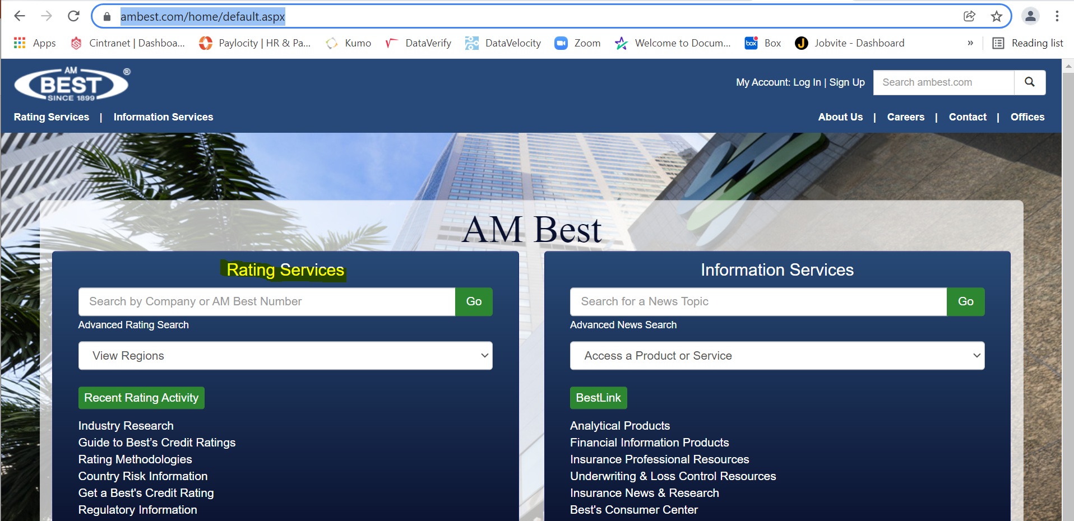
Reviewing Insurance Company – This process to be used at the discretion of Sr. Management
The Insurance Company must be licensed to do business in the state in which the mortgage property is located. In addition they must be rated B+/ IV in Best’s Insurance Reports (or Lloyd’s of London).
Website: https://www.ambest.com/home/default.aspx
NOTE: the Borrower/Guarantor (if applicable) cannot be associated with the Insurance Company

Slide 14
Flood Insurance
A Flood Certificate is pulled on every loan. If a property is in a flood zone, Flood Insurance is required.
Flood Insurance is reviewed for all of the following pieces of information (Just like Hazard Insurance)
Name of Insured
Property Address/Insured Location
Effective Date
Deductible
Premium – Must be paid in full prior to closing/funding unless it is an existing policy that has already been paid.
Mortgagee Clause
Review of Insurance Company
The one item that is reviewed differently is the Amount of Coverage.
The amount of coverage should cover the loan amount up to a max $250k. If loan amount exceeds $250k generally they will not increase the coverage past this amount. HOWEVER if they do have coverage more than $250k it is acceptable.

Slide 15
Condo Master Insurance Policy
Walls Out – If the Condo Master Insurance policy is Walls out only, Acra reviews for the following:
1. Correct HOA name as the Insured Party
2. Building Subject Property is located in is listed on the policy
Walls In – If the Condo Master Insurance policy also contains walls in coverage, Acra will require the following:
Same requirement as HO3 Policy on an endorsement to the Condo Master Insurance Policy
Fidelity Coverage minimum $50,000

